Slide 1


IPL Stadium Operations Blueprint
Rajiv Gandhi International Cricket Stadium

Slide 2

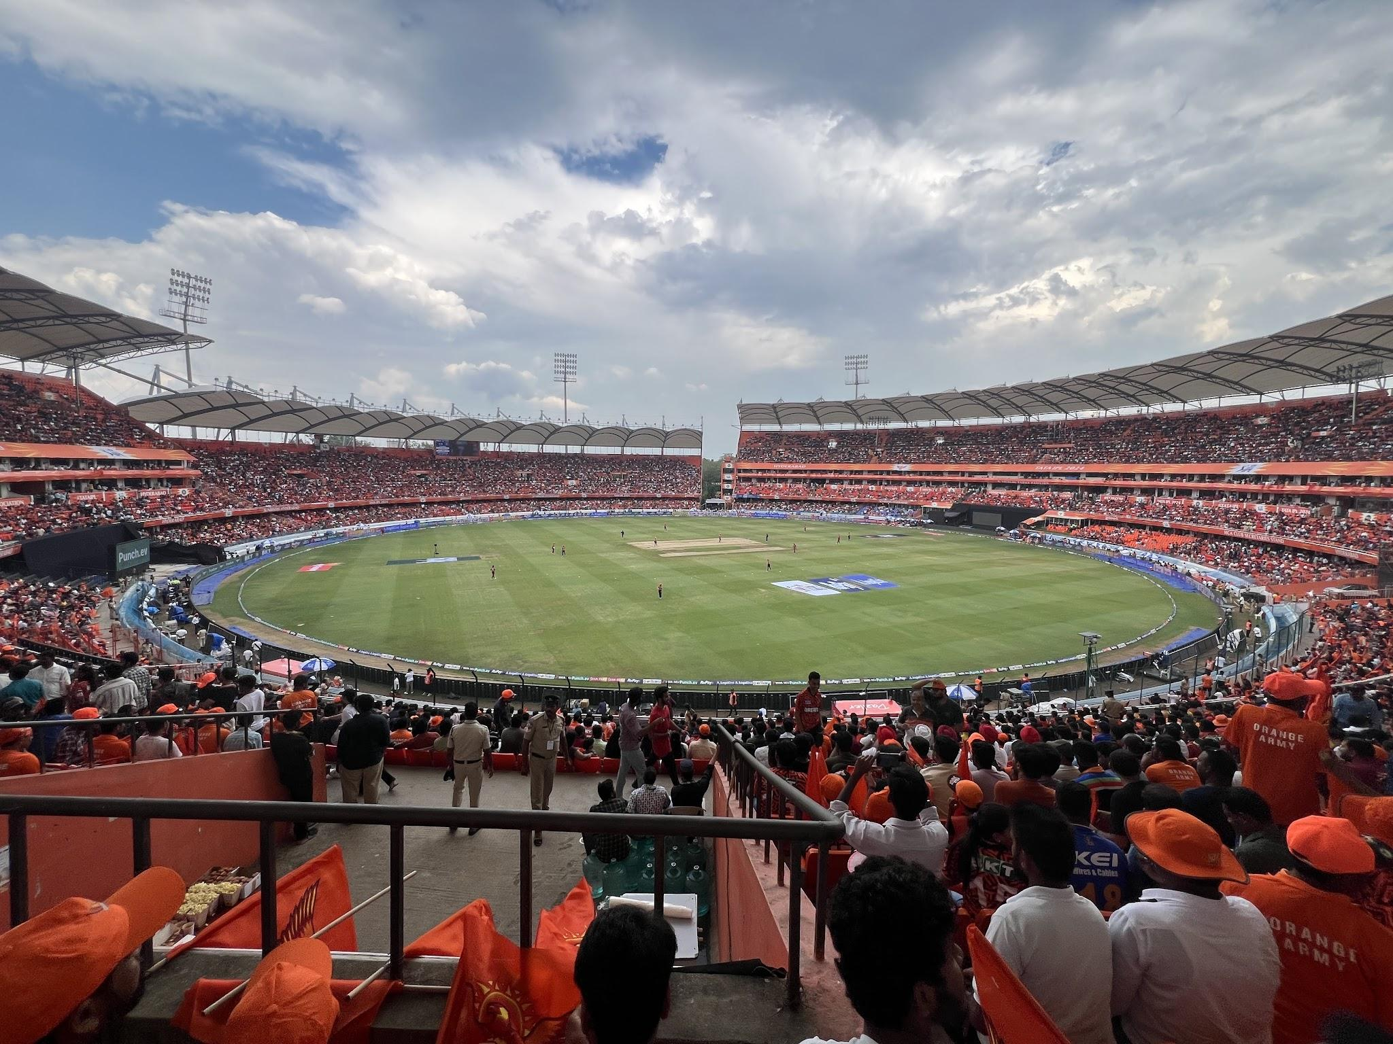

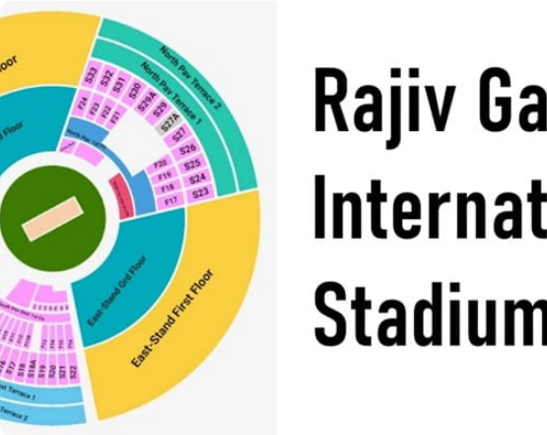
PROJECT OVERVIEW
Comprehensive stadium logistics blueprint
End-to-end fan journey management
Safety-first approach for massive crowds
Resource optimization for IPL fixtures

Slide 3
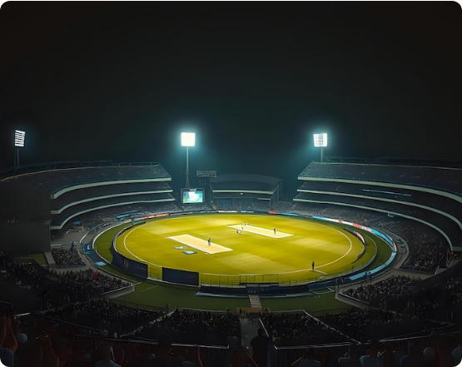
EVENT DETAILS
Metric | Information
League | Indian Premier League (IPL)
Location | Hyderabad, India
Host Team | Sunrisers Hyderabad (SRH)
Stadium Capacity | 38,000+ Spectators

Slide 4

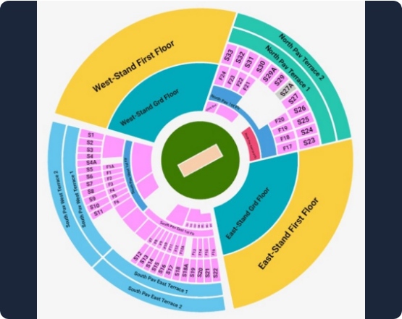





GATE MANAGEMENT STRATEGY

Slide 5






CROWD FLOW MANAGEMENT
↓
↓
↓
↓
↓

Slide 6

MATCH DAY TIMELINE
3 PM
4 PM
5:30 PM
6 PM
Gates Open
Tech Checks
The Toss
Match Start
Operations teams must synchronize their schedules to ensure security sweeps are finalized before 3 PM. Effective transition management from pre-match warm-ups to the live broadcast start is critical for stadium success.

Slide 7






VENDOR MANAGEMENT
Food Stalls
Water Points
Merch Zones
Sponsors

Slide 8


VOLUNTEER DEPLOYMENT
100
TOTAL ACTIVE DEPLOYMENT

Slide 9





MEDICAL & EMERGENCY OPERATIONS
↓
↓
↓

Slide 10






SECURITY OPERATIONS

Slide 11
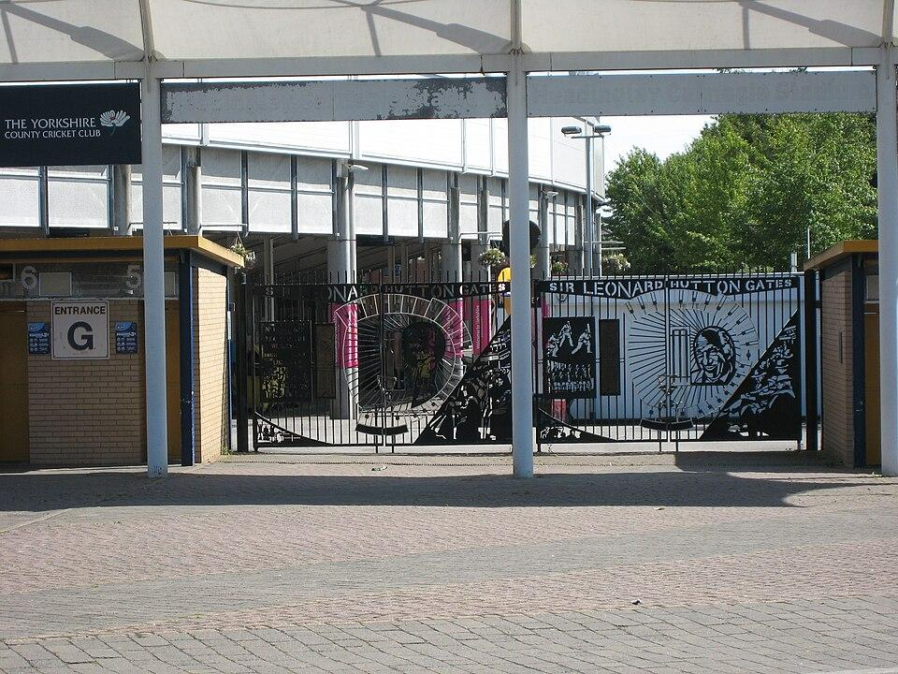




EXIT STRATEGY
↓
↓
↓

Slide 12
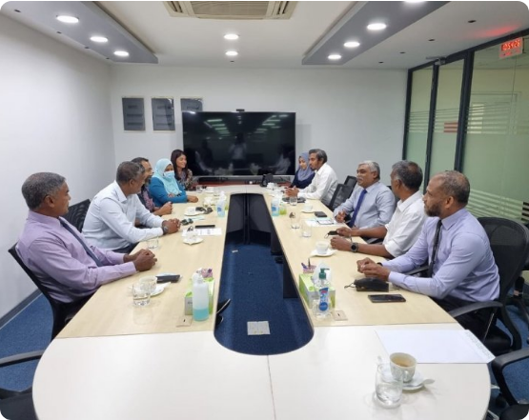






POST-MATCH REVIEW

Slide 13







KEY LEARNINGS
Crowd Dynamics
Response Agility
Security Focus
Communication
Stadium Ops
Event Data

Slide 14
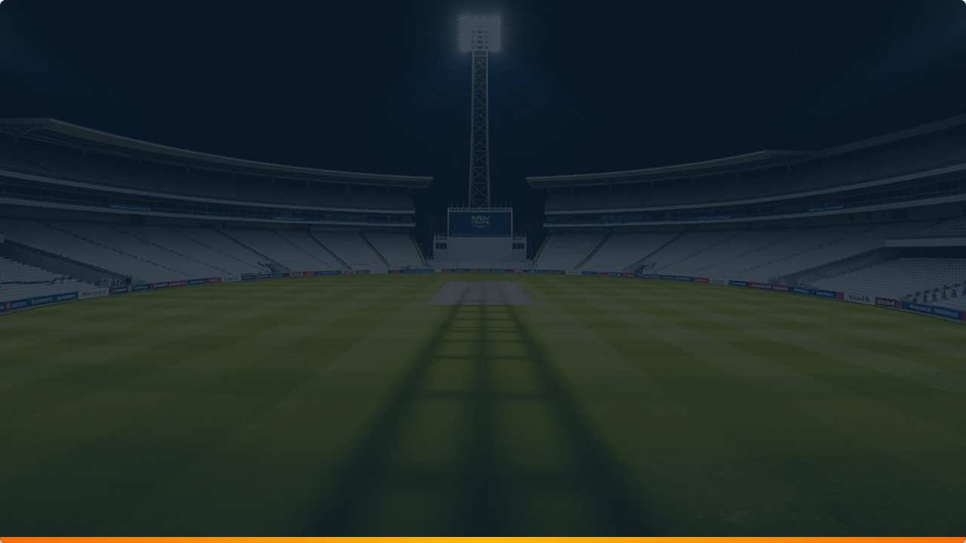
Conclusion
A comprehensive IPL stadium operations blueprint designed to ensure safe, efficient, and successful match-day execution through structured planning, coordination, and continuous improvement.

